Slide 1

Exploring Predictos Related to Diabetes
Seth Galluzzi, Haley Egan, JD Pinto, and Sydney Masterson

Slide 2
AIM
The aim of this project was to gain an understanding of different variables that relate to diabetes.
RATIONALE
We used visualizations to explore relationships between variables.
We analyzed the prevalence of diabetes within African American communities in central Virginia.

Slide 3
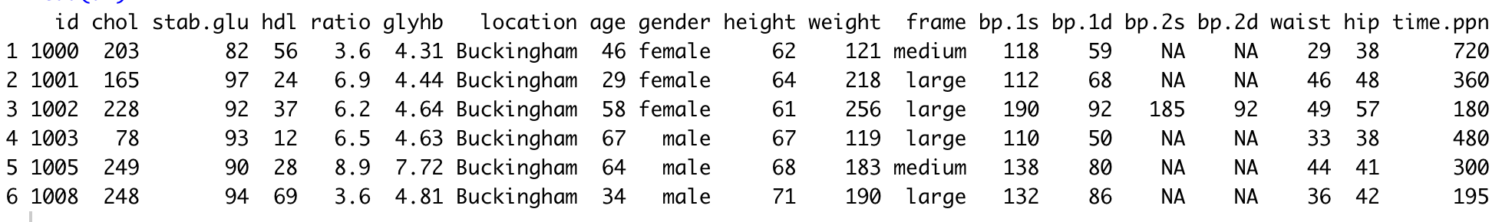
THE DATA
Faraway package in R: diabetes.
403 objects and 19 variables.
Numeric continuous variables: cholesterol, age, weight, and high density lipoprotein.
Categorical variables: gender, location, and frame.
Notes:
The data set we explored is within the faraway package in R and is called diabetes.
The data set has 403 objects and 19 variables.
The data includes numeric continuous variables such as cholesterol, age, weight, and high density lipoprotein.
The data also includes categorical variables such as gender, location, and frame.

Slide 4
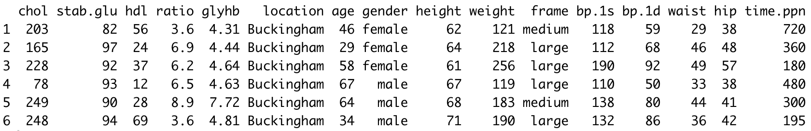
DATA CLEANING
Dropped: id column, second systolic and second diastolic blood pressure columns.
Filled the missing values in the remaining columns with the median of each column and added a categorical variable, diabetes, for some visualizations.
Notes:
Though our data was relatively clean, we did complete some cleanup before creating visualizations.
We dropped the id column and the second systolic and second diastolic blood pressure columns from the data set.
We also filled the missing values in the remaining columns with the median of each column and added a categorical variable, diabetes, for some visualizations.

Slide 5
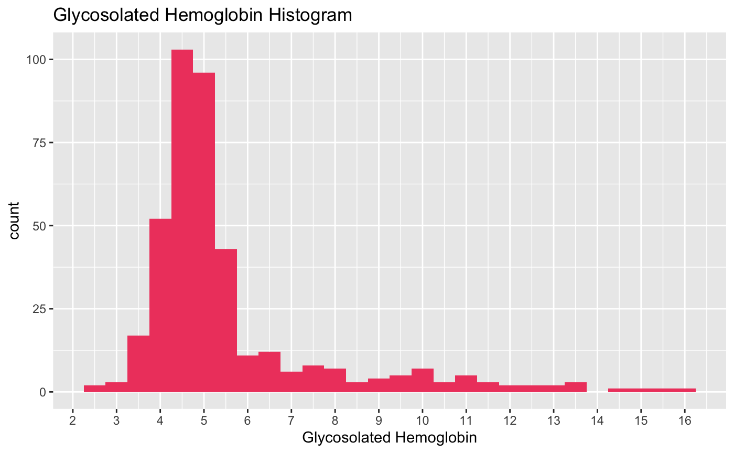
EXPLORING VISUALIZATIONS
Notes:
We created visualizations between variables such as weight, age, and glycosylated hemoglobin.
We determined that glycosylated hemoglobin was best response variable to explore diabetes.

Slide 6
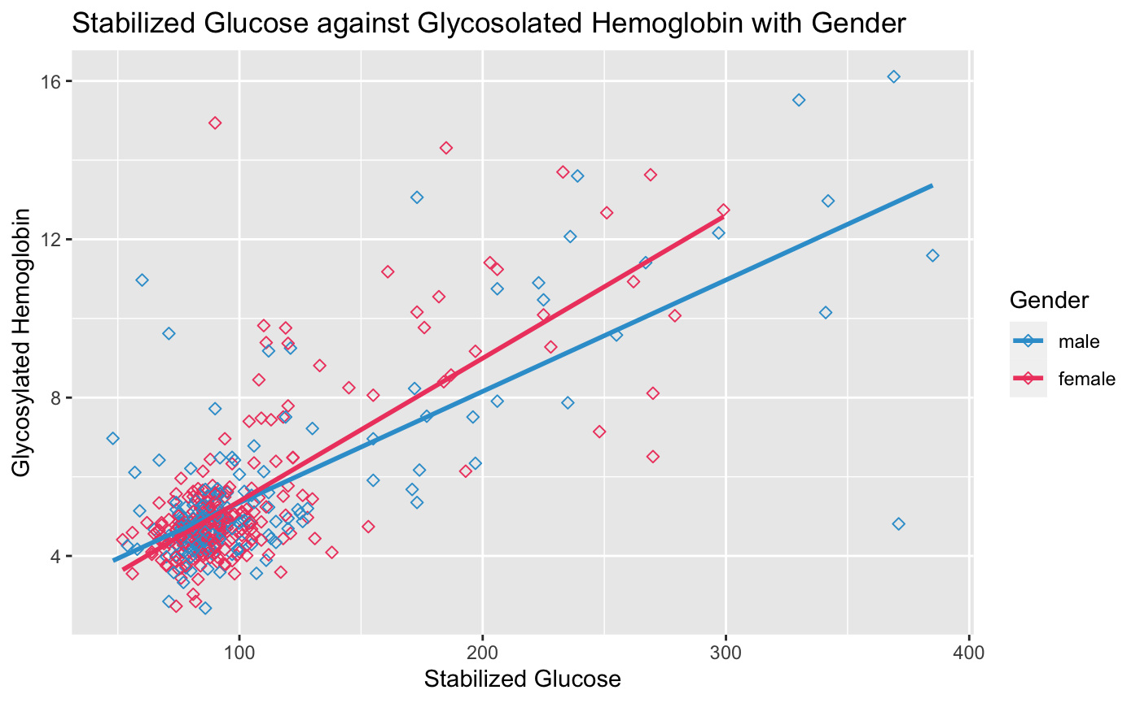
EXPLORING VISUALIZATIONS
Notes:
We created visualizations between variables such as weight, age, and glycosylated hemoglobin.
We determined that glycosylated hemoglobin was best response variable to explore diabetes.

Slide 7
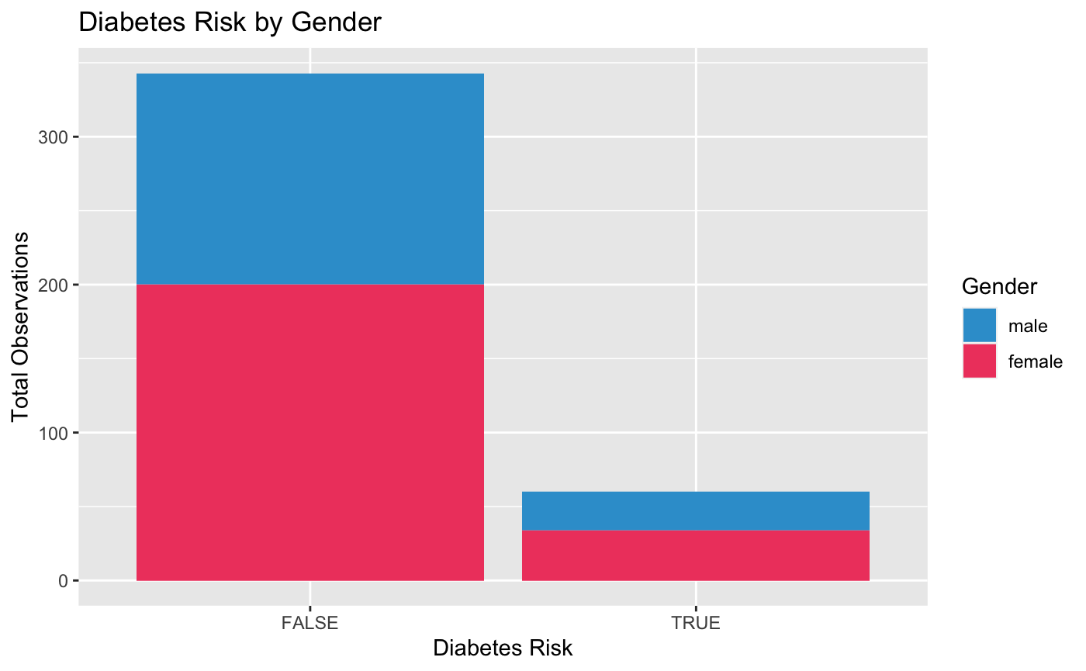
EXPLORING VISUALIZATIONS
Response: Glycosylated hemoglobin
~14.9% of subjects considered at risk of diabetes
diabetes = TRUE when glycosylated hemoglobin >7
Notes:
Glycosylated hemoglobin was chosen as a response for its connection to diabetes.
A new variable measuring diabetes risk was introduced.
The categorical variable diabetes had a value of TRUE when glycosylated hemoglobin was above 7.
Our data showed ~14.9% of our subjects were considered at risk of diabetes.

Slide 8
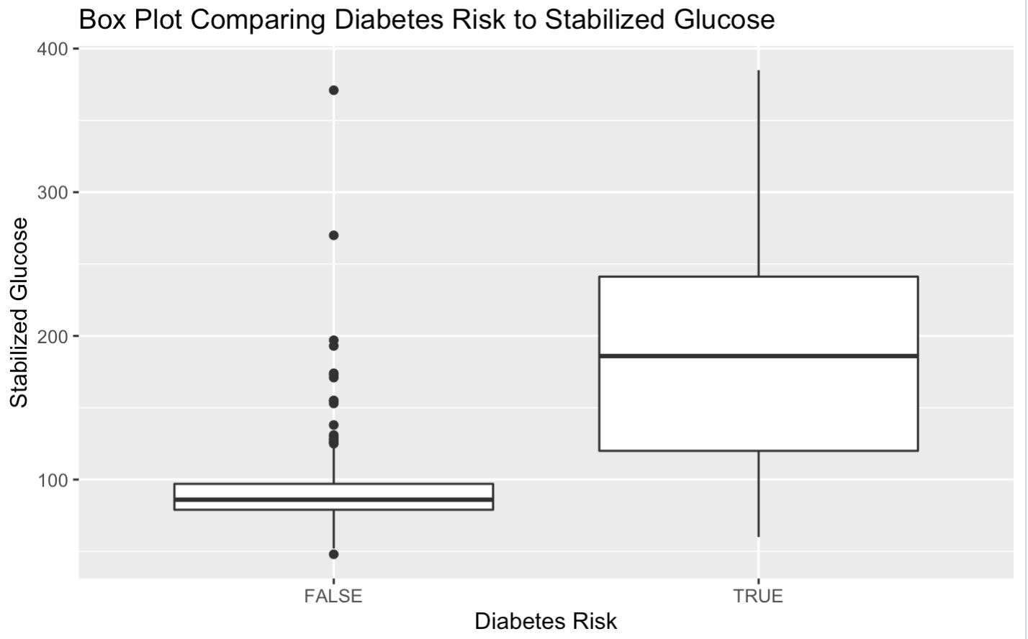
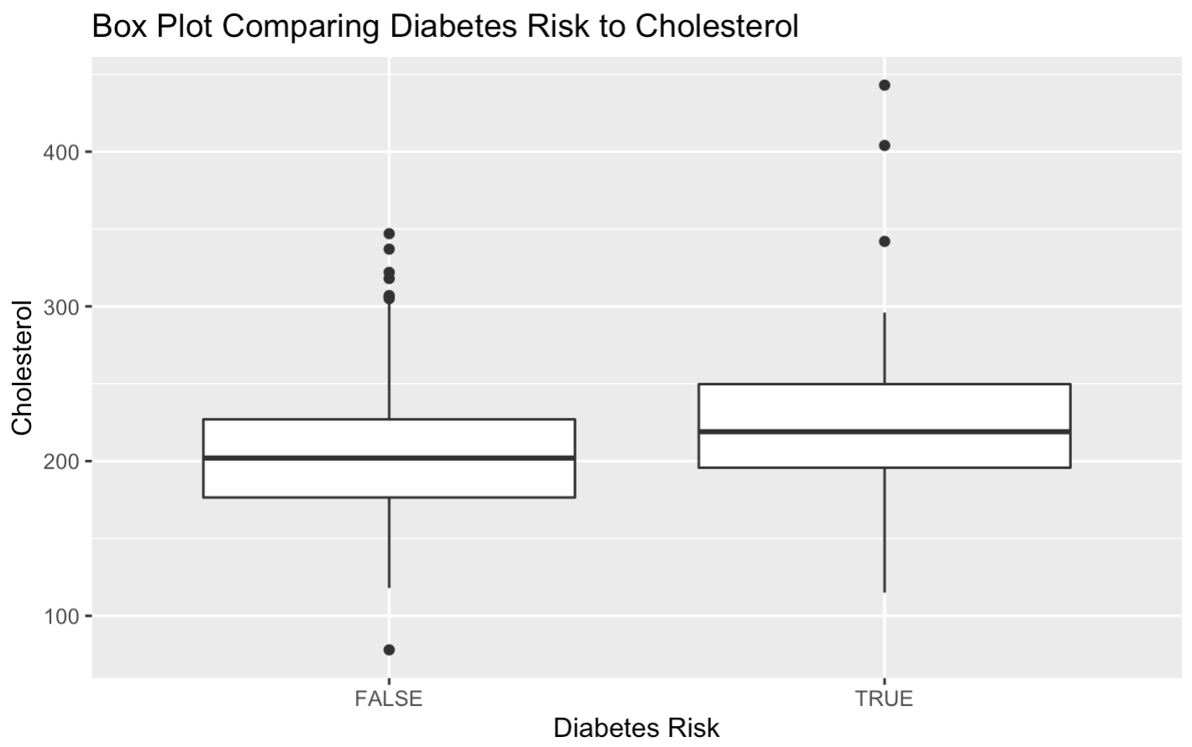
EXPLORING VISUALIZATIONS
The visualizations below illustrate the differences in stabilized glucose and cholesterol of subjects with and without a risk of diabetes.

Slide 9
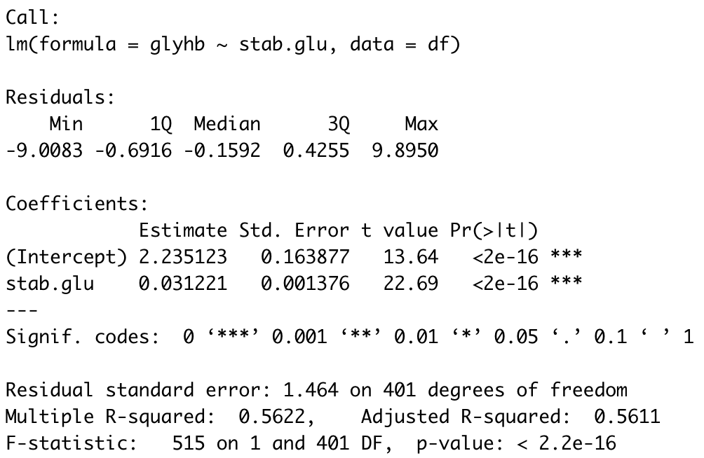
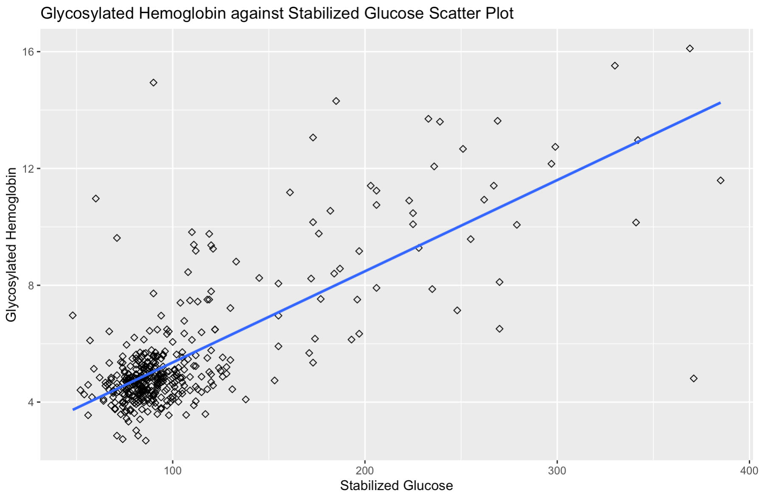
EXPLORING LINEAR REGRESSION
The regression indicates a positive relationship between stabilized glucose and glycosylated hemoglobin.
Notes:
The regression indicates a positive relationship between stabilized glucose and glycosylated hemoglobin.

Slide 10
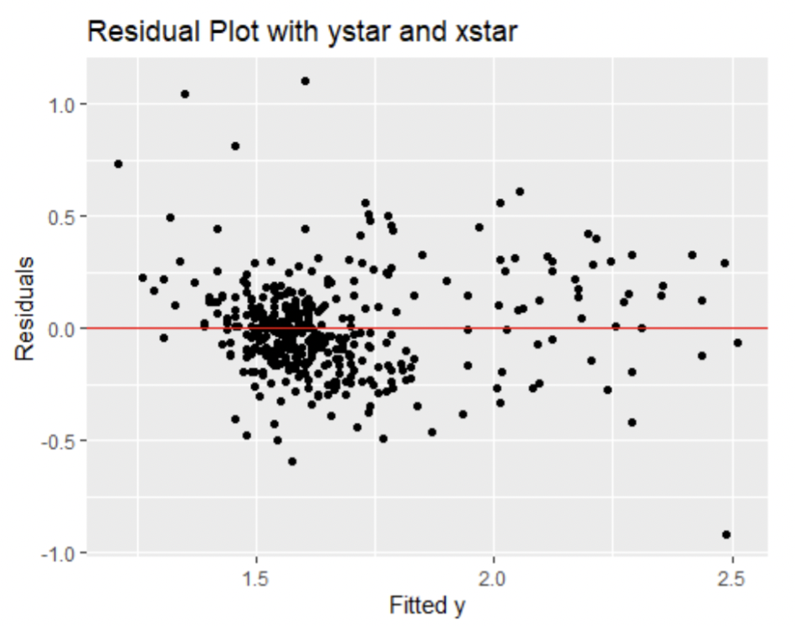
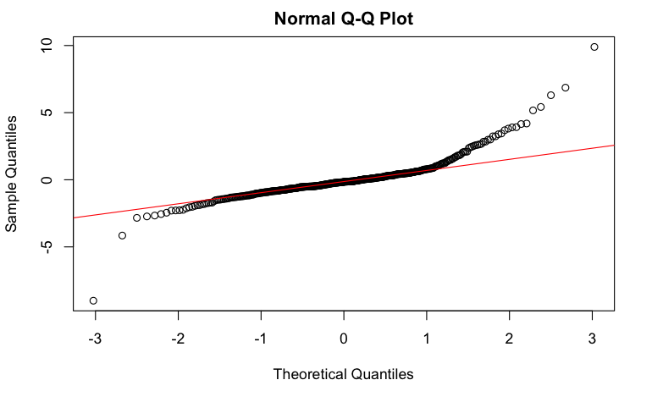
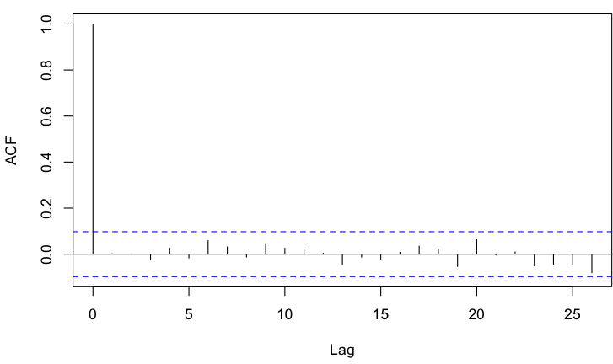
SATISFYING REGRESSION ASSUMPTIONS:
Linear relationship
Error terms normally distributed
Constant variance
Independent observations
Notes:
A linear relationship
Error terms normally distributed
Constant variance
Independent observations

Slide 11
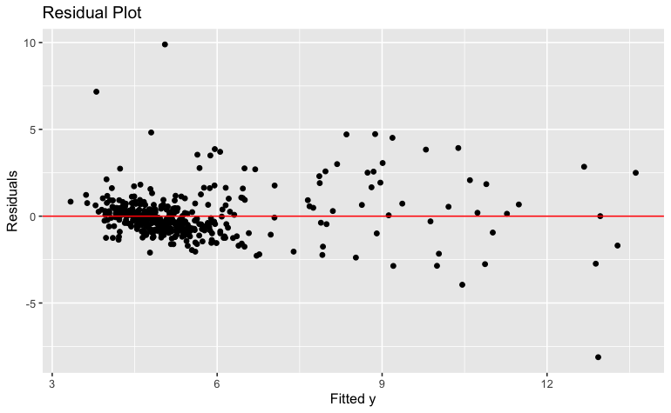
RESIDUAL COMPARISON BEFORE AND AFTER TRANSFORMATIONS

Slide 12
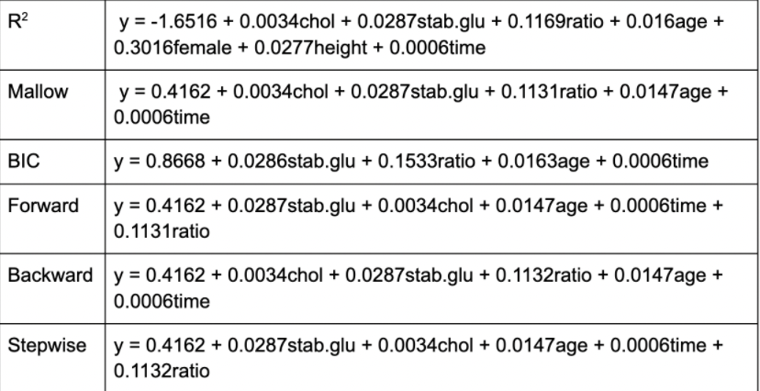
MODEL SELECTION
After model diagnostics, we chose cholesterol, stabilized glucose, age, postprandial time, and ratio as predictors.

Slide 13
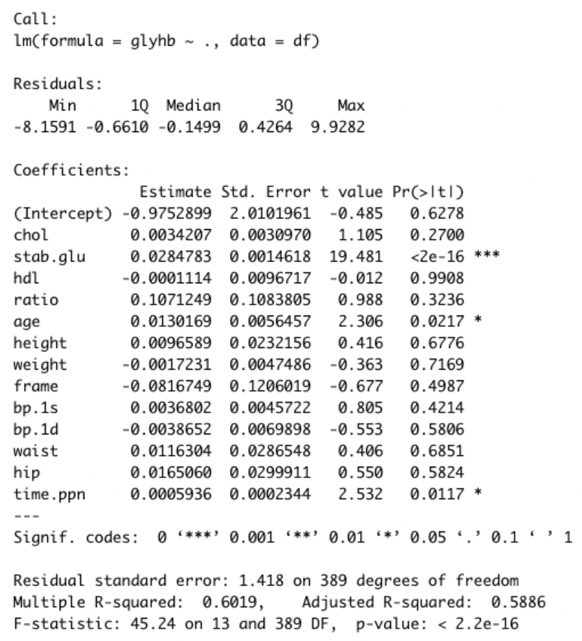
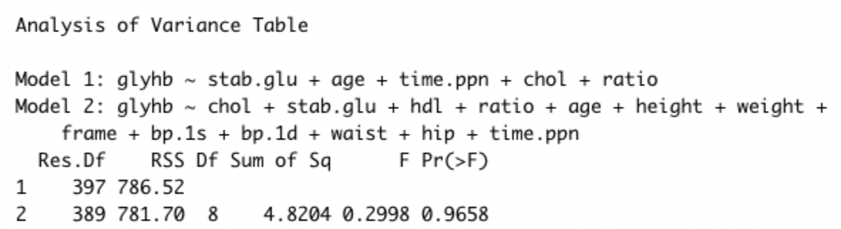
MLR
After comparing two models, it was determined that model 1 would be best suited for our data.

Slide 14
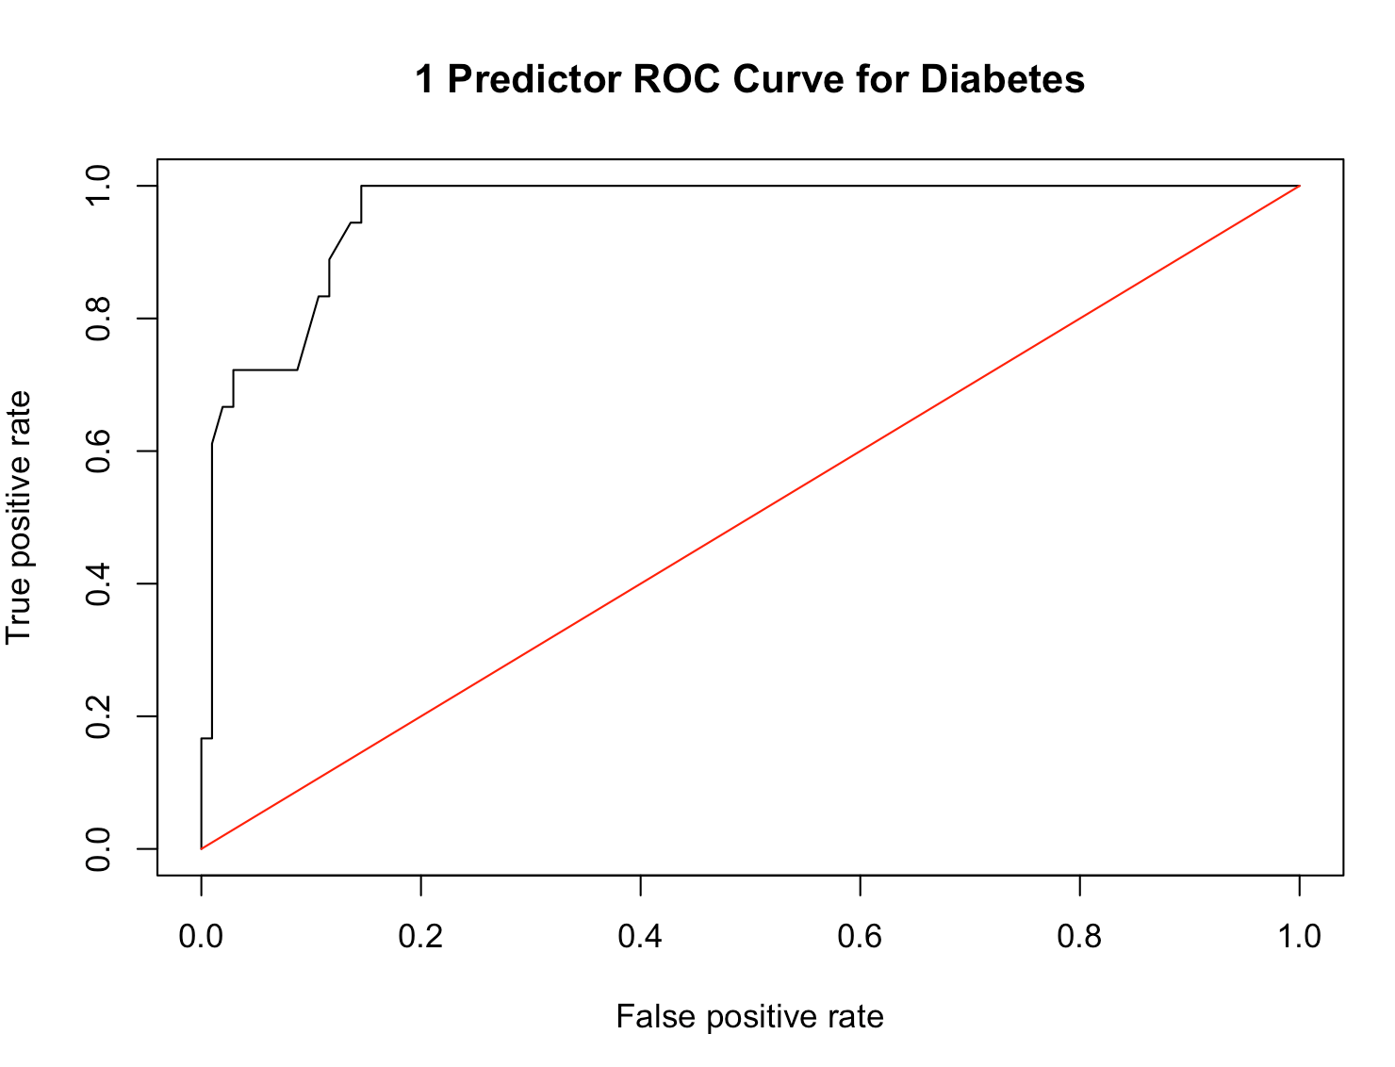
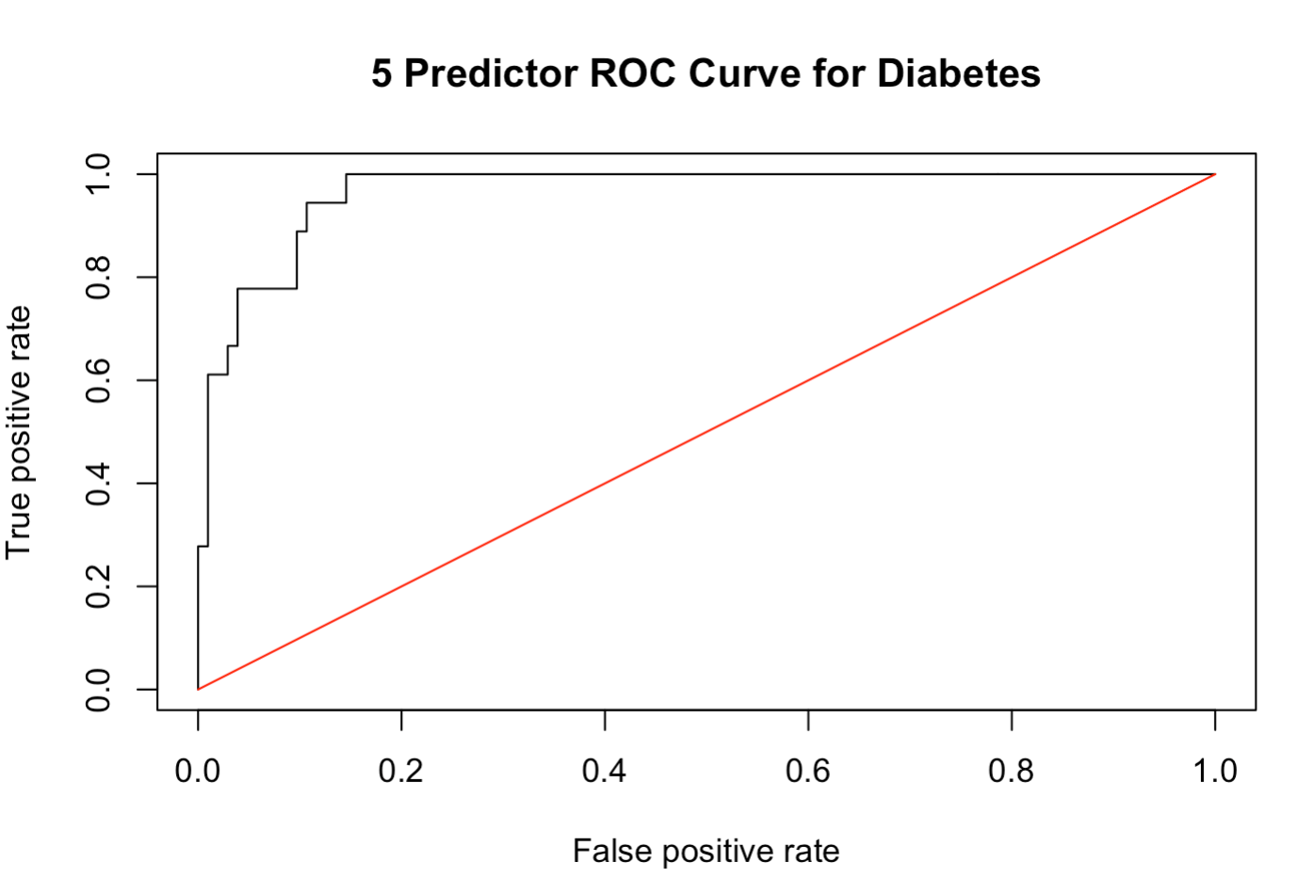
Comparing ROCs and AUCs
Data indicated a simple linear regression model was nearly as effective in predicting diabetes risk as our 5 predictor model.
Notes:
Data indicated a simple linear regression model was nearly as effective in predicting diabetes risk as our 5 predictor model. The AUC scores were 0.960 and 0.966, respectively.
The AUC scores were 0.960 and 0.966, respectively.

Slide 15
ISSUES, NOTES, AND INSIGHTS
Size of the data set
Missing values and data not collected
SLR vs MLR
Time to explore other variables
6.5 vs 7
I can do more, to lower my A1C.

Slide 16
SUMMARY
We compared visualizations between variables such as glycosylated hemoglobin, stabilized glucose, and diabetes risk.
Predictors such as age, total cholesterol, and stabilized glucose can impact diabetes risk.
A linear regression relating stabilized glucose to glycosylated hemoglobin was most appropriate.
Increase awareness of different predictors related to diabetes.

